Slide 1
multinational suicide Analysis

Slide 2
Table of contents
Data
Data Limitations
Data Cleaning
Exploratory Data Analysis
Linear Regression Analysis
Code

Slide 3
Data
Public data can be found here
Data weas compiled through aggregation of four public datasets
Contains number of suicides across 101 countries by year, age group, sex, population, GDP, GDP per capita, GDI, country-year, and generation
Age groups are compartmentalized in factors of 5 – 14, 15 - 24, 25 – 34, 35 – 54, 55 – 74, and 75+
Data was collected from 1985 – 2016
1985, 1986, and 2016 were cut out of analyses because of missing data

Slide 4
Data Limitations
Age is measured on a factor scale
The factors that measure age are not equivalent
The factors of 5 – 14, 15 - 24, and 25 – 34 are measured on 10 year intervals
The factors of 35 – 54 and 55 – 74 are measured on 20 year intervals
The factor of 75+ is measured on an arbitrary interval
Not all countries in the world are included

Slide 5
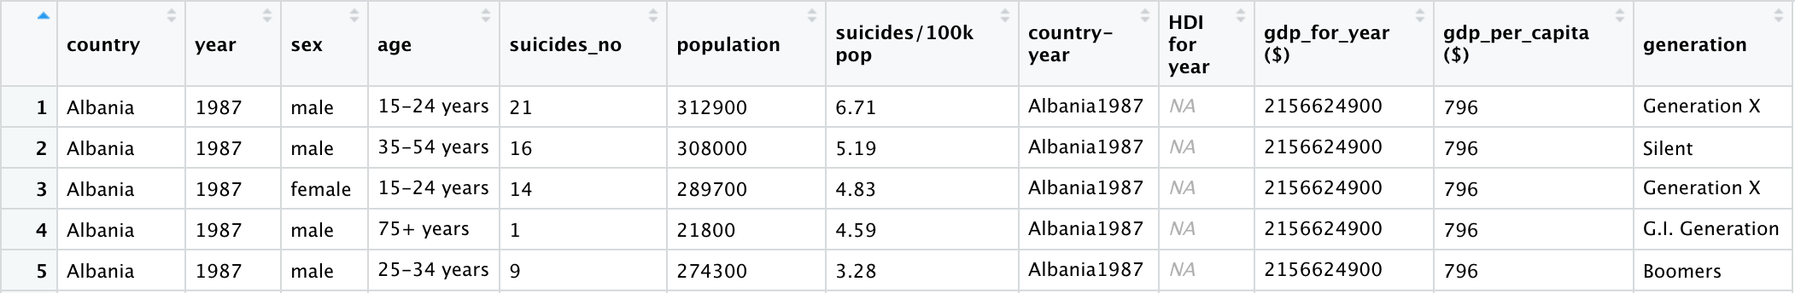
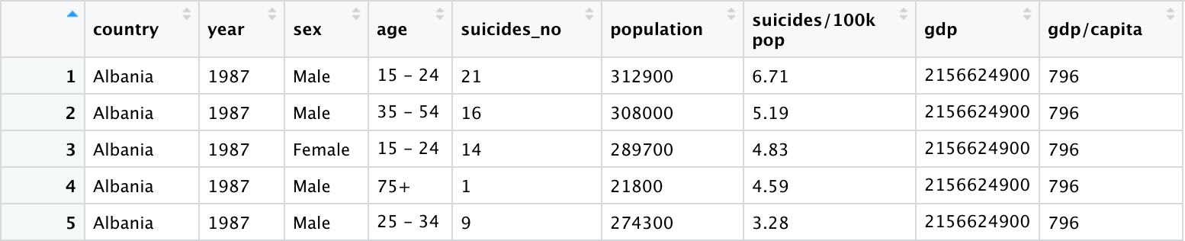
Data cleaning
Column names and values were renamed for readability
Categorical values outside of countries were converted to factors
HDI, Generation, and Country-Year variables were eliminated due to redundancy

Slide 6
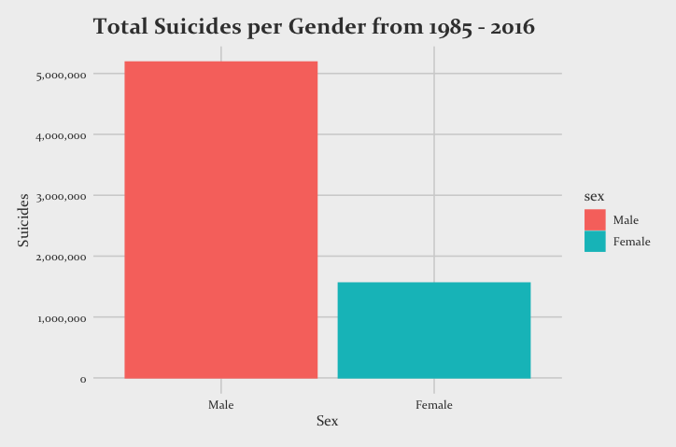
Exploratory data analysis Gender variation
Total amount of suicides is over 3x as high among males than it is for females within this dataset
 | Male | Female
Suicides | 5,188,910 | 1,559,510

Slide 7
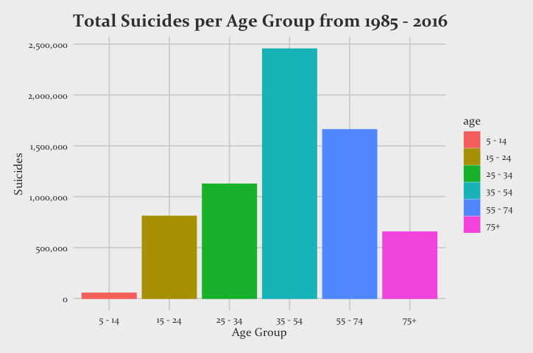
Exploratory data analysis age group variation
Age Group | Suicides
5 - 14 | 52,264
15 - 24 | 808,542
25 - 34 | 1,123,912
35 - 54 | 2,452,141
55 - 74 | 1,658,443
75+ | 653,118
The total amount of suicides is highest among the 35 – 54 and 55 – 74 age groups, but that is to be expected given the largest factor intervals.

Slide 8
Exploratory data analysis Suicides per country by year
Russia, Lithuania, and Korea all have the highest suicide rates per country when adjusted for population. The United States and Russia have the highest raw number of suicide rates within this timeframe

Slide 9
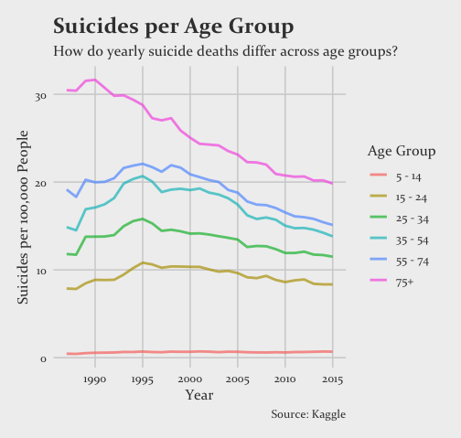
Exploratory data analysis Suicides per age group by year
Suicides in the countries outlined in the data seem to be decreasing at a steady rate across all age groups

Slide 10
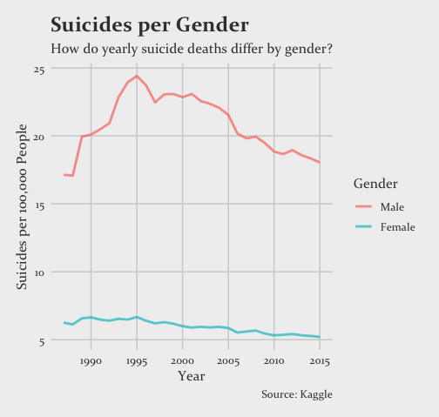
Exploratory data analysis Suicides per Gender by year
Suicides in the countries outlined in the data seem to be decreasing at a steady rate across both genders, but suicides are over two times as prevalent among males

Slide 11
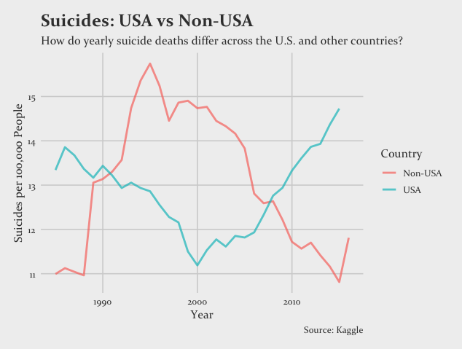
USA Exploratory data analysis USA vs non-usa
Since 2007, suicides among non-USA countries in the dataset have decreased, with a slight spike in 2015. Suicides have been steadily increasing in the USA since 2000 and were at a historical high in 2015.

Slide 12
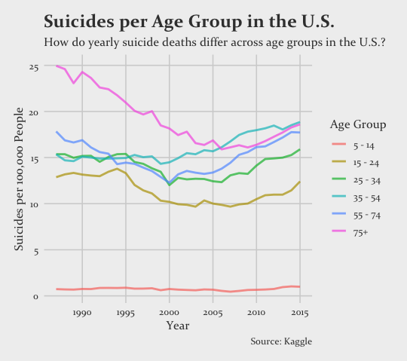
USA Exploratory data analysis suicides per age group in the us
Since 2005, US suicides have been increasing across all age groups, barring the 5 – 14 interval.

Slide 13
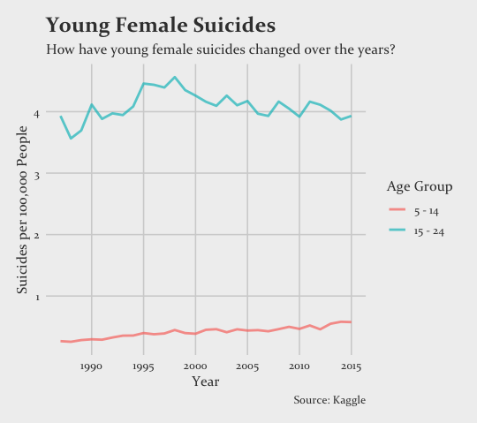
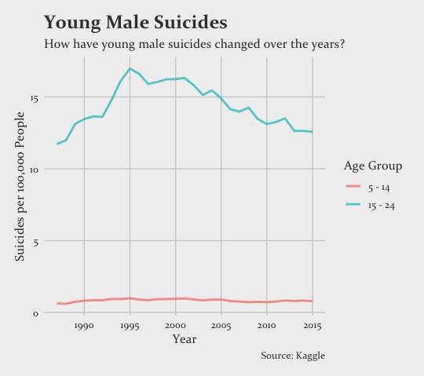
Exploratory data analysis young suicides
Among the countries listed in the dataset, young female suicides have remained steady around 4 per 100K (15 – 24) and less than 1 (5 – 14). Young male suicides have been decreasing among the 15 – 24 age group and remain steady among the 5 – 14 age group.

Slide 14
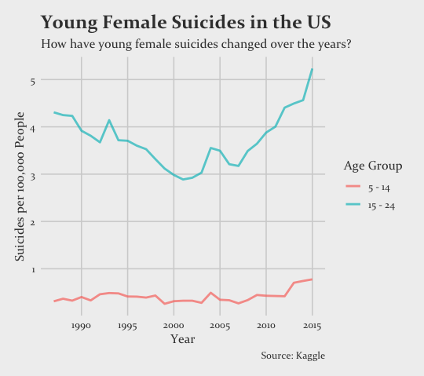
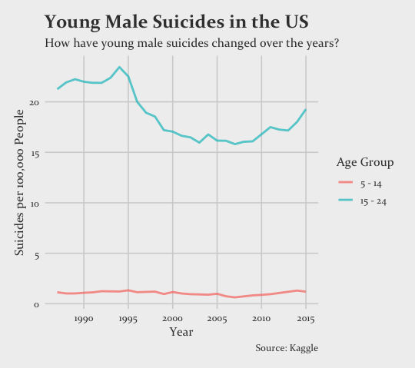
Exploratory data analysis young suicides in the us
Within the US, young female suicides have been drastically increasing since 2007 among the 15 – 24 age group slightly increasing in the 5 – 14 age group. Young male suicides have been increasing among the 15 – 24 age group and remain steady among the 5 – 14 age group.

Slide 15
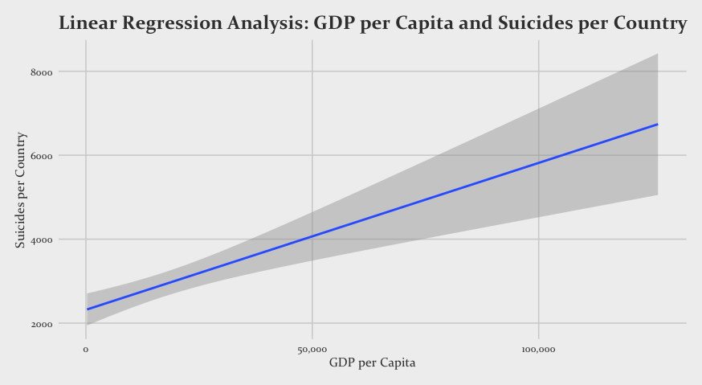
Linear Regression analysis
R² = .008
Although the R² value is small, the small relationship is still prevalent between GDP/capita and suicides per country.
 | Coefficient | SE | T-value | P-value
Intercept | 2317 | 196.2 | 11.81 | < .001
GDP/Capita | 0.035 | 0.0077 | 4.52 | < .001

Slide 16
Github Repository

